Slide 1
Introduction
Name: Etinosa Ekomwenrenren
Course: Data Science Immersive
Topic: Tableau Project
October 2023

Slide 2
Outline
Problem introduction
Exploratory data analysis
Answering real estate questions with visualizations
Challenges and future directions
Notes:
Average time: 1 minute 35 seconds

Slide 3
Problem Introduction
Learning Objectives
Option 1 project type selected
Answer pre-supplied questions relating to real estate prices and affordability in Canada
Explore dataset to deepen understanding
Create visualizations in Tableau to answer provided questions
Turning data into visual insights using Tableau
Communicating insights with the appropriate visualizations
Notes:
Average time: 1 minute 35 seconds

Slide 4
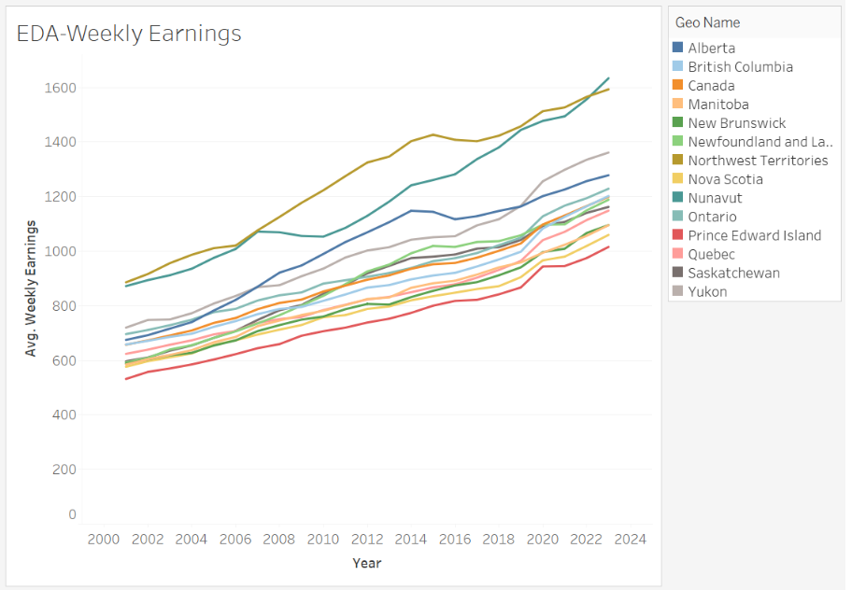
Exploring Datasets
Provided datasets include information about:
Residential house prices
Office building prices
Average weekly earnings
Inflation measured as a consumer price index
Housing constructions
Interesting to note that the colder Northern provinces have higher average weekly earnings
Notes:
Average time: 1 minute 35 seconds

Slide 5
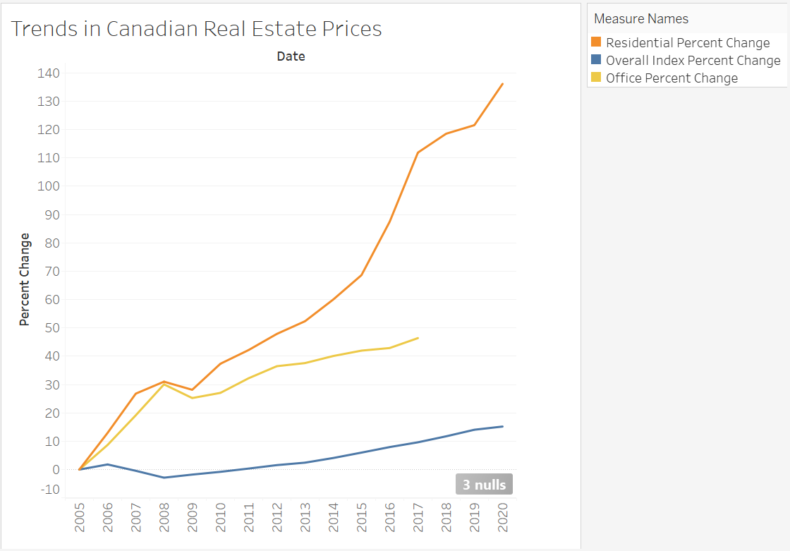
Should You Wait to Buy a House?
Trend information are better capture with line charts
2005 is used a base year and data recalculated
Residential house prices have been accelerating faster in comparison to the overall index and to office prices
Notes:
Average time: 1 minute 35 seconds

Slide 6
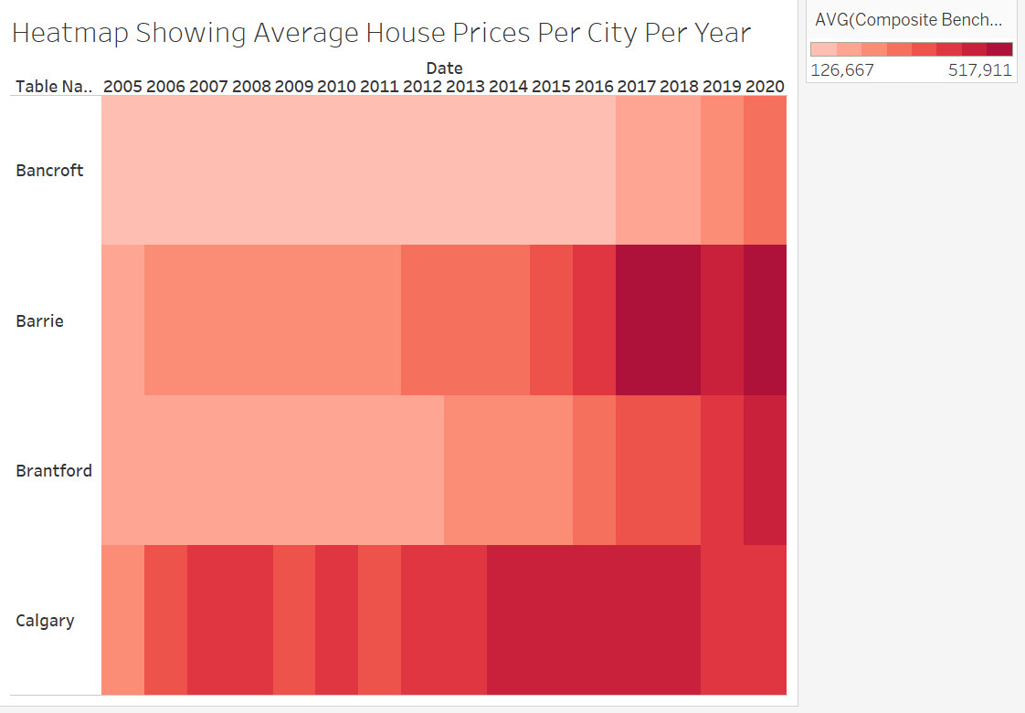
Are House Prices in Calgary More Expensive than Bancroft?
Heatmaps are good for showing variation across multiple dimensions
The two dimensions here are year and city.
House prices in Calgary have been consistently more expensive than in Bancroft.
Notes:
Average time: 1 minute 35 seconds

Slide 7
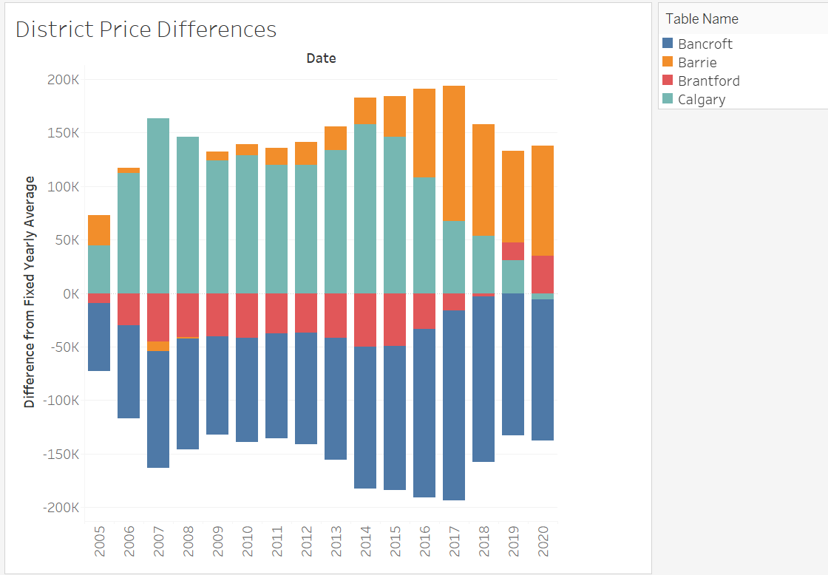
Are House Price Differences between the Cities Increasing?
Diverging bar charts are good for showing differences across categories and an average
Recently, the price differences between the cities have been decreasing as prices in Bancroft and Brantford catch up to the average
Notes:
Average time: 1 minute 35 seconds

Slide 8
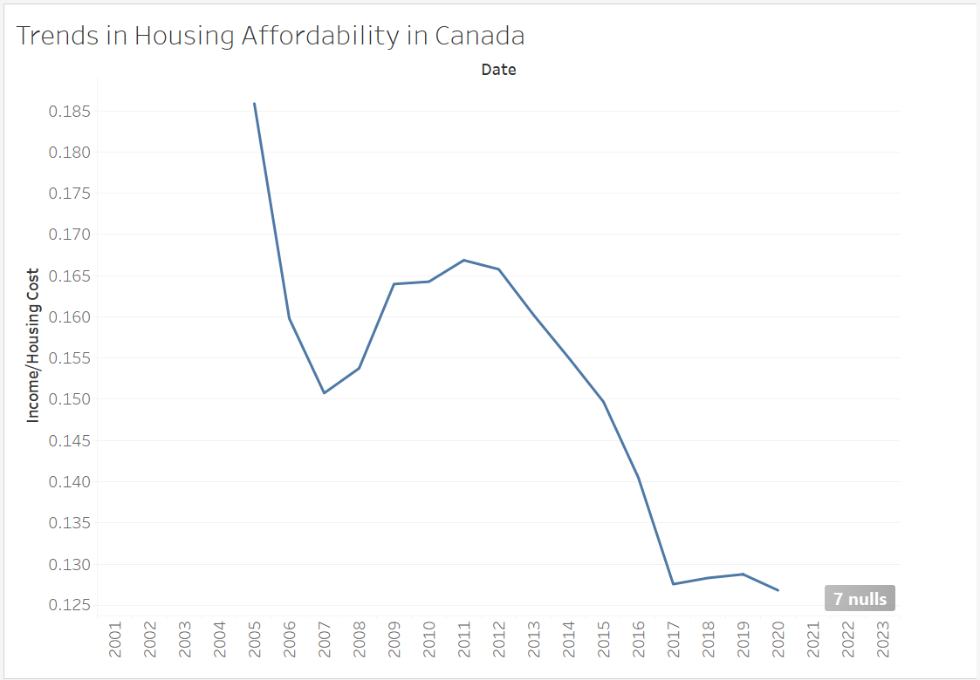
Are Houses More Affordable Than in the Past?
Trends are better captured with line charts
House prices have grown faster than the rate of increase in salaries/wages
House prices are increasingly becoming more unaffordable
Notes:
Average time: 1 minute 35 seconds

Slide 9
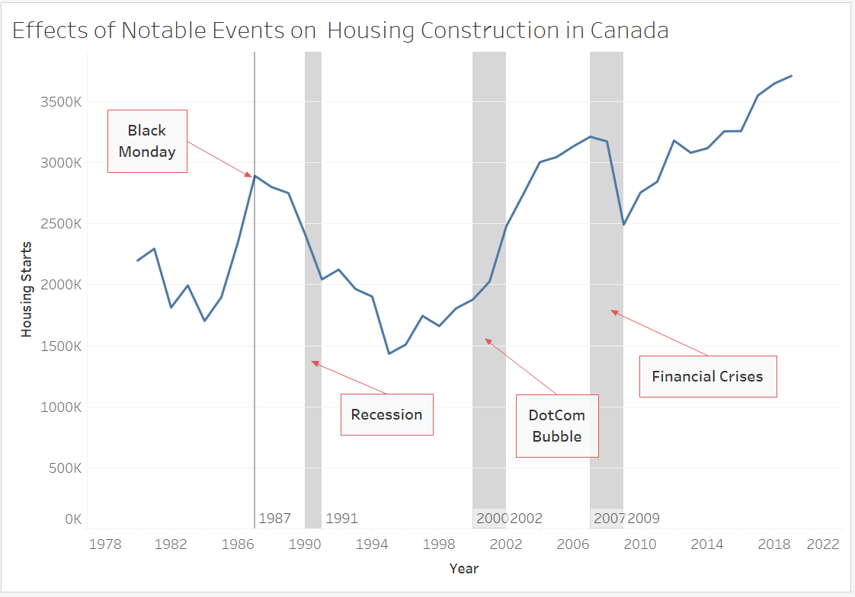
Do People Stop Building Houses When the Economy is Bad?
Annotations using reference bands/lines are good for highlighting notable events
Recessions that affect the broader economy lead to reduction in housing starts
Events isolated to sectors – like the Dot Com Bubble – are less impactful on housing starts
Notes:
Average time: 1 minute 35 seconds

Slide 10
Challenges and Future Directions
The main challenge was in the provided files/datasets
The weekly earnings json file was not usable. I had to re-source it.
The housing index dataset is essentially a copy of the CPI dataset. I had to segment it and proceed with the file as is.
With more time, it would be interesting to enrich the present dataset and get more geographic granularity into house prices across Canada.
Notes:
Average time: 1 minute 35 seconds

Slide 11
Thank you

